Slide 1
ProxyMITY XML Editing Tool
Project Team:
Ankur Sharma
Anuj Nagpal
Shubham Gupta

Slide 2
Introduction
Provide the ProxyMITY Tool with the XML File having the details regarding the video lecture.
Can generate New XML Files / Modify already existing XML.

Slide 3
Problem Statement
For Creating and Modifying the xml file used by ProxyMITY Tool using GUI.
This tool should be platform independent and should provide a user friendly environment for tedious task.

Slide 4
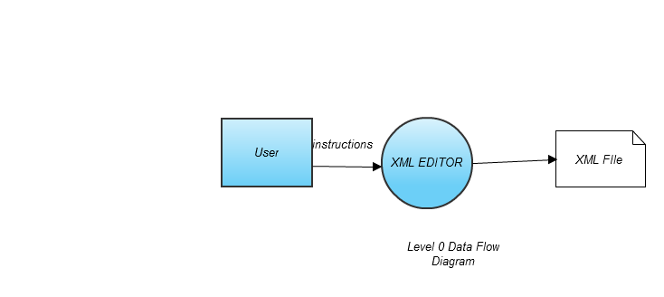
Data Flow Diagram level 0

Slide 5
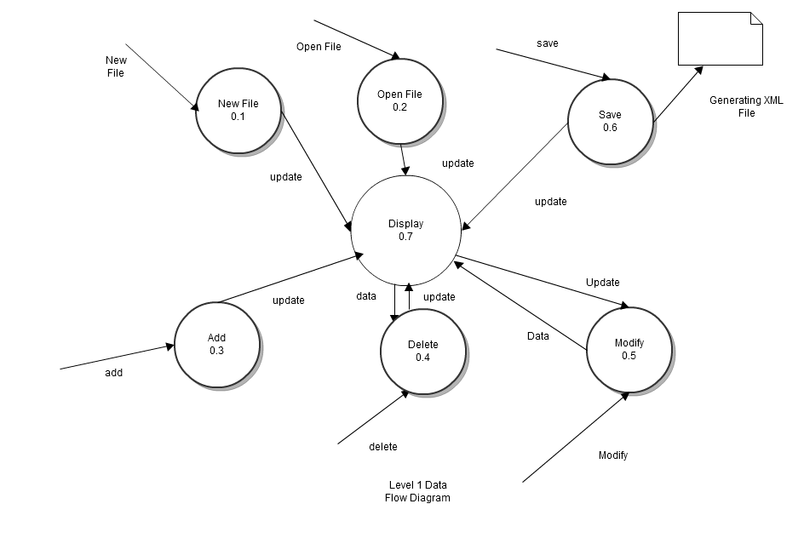
Data Flow Diagram level 1

Slide 6
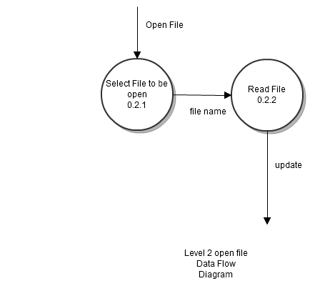
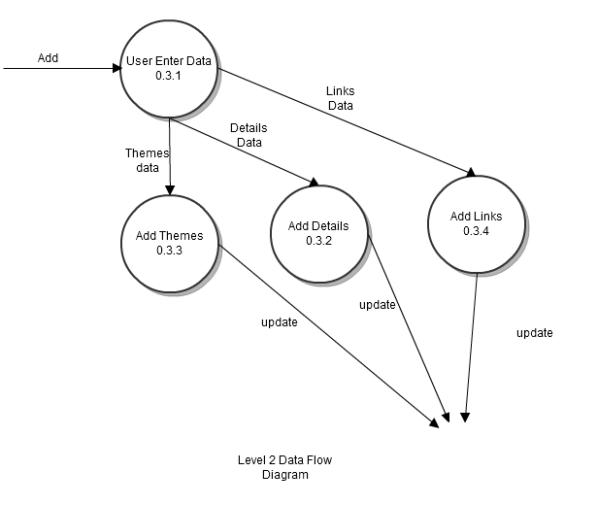
Data Flow Diagram level 2
Process-Open File
Process-Add

Slide 7
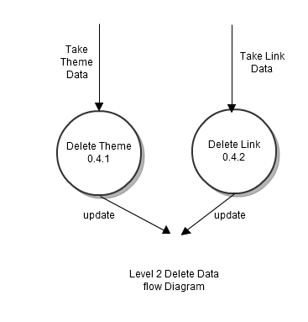
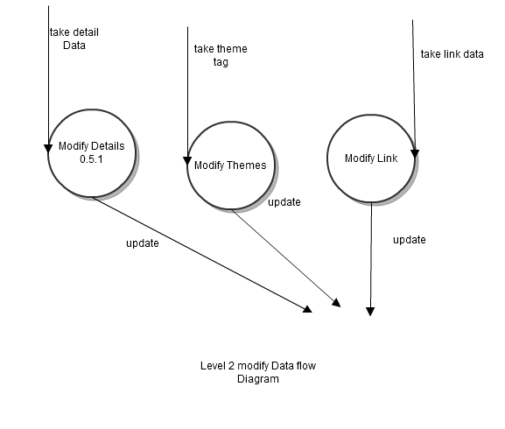
Data Flow Diagram level 2
Process-Delete
Process-Modify

Slide 8
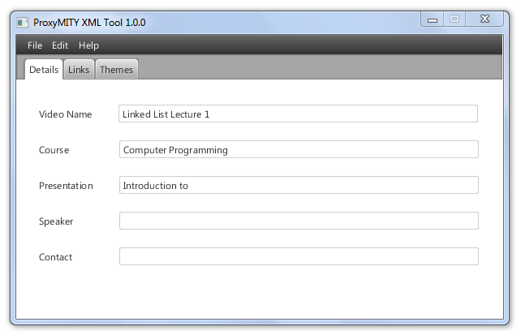
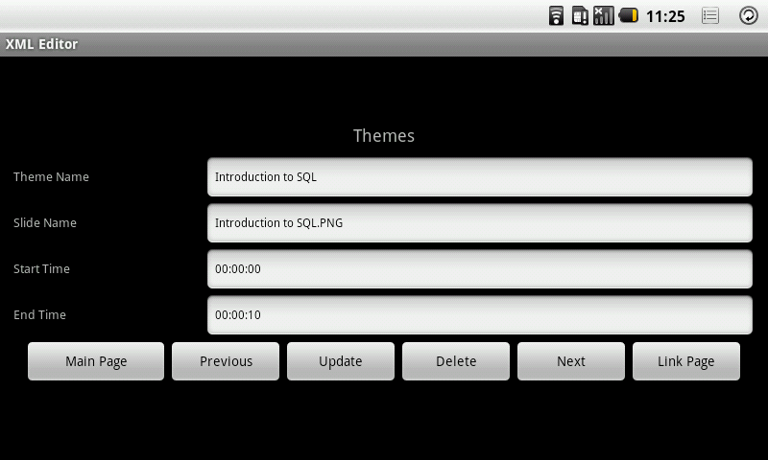
GUI & DEMO
Desktop Version
Android Version

Slide 9
Advantages
Works on any Operating System supporting java platform.
Application will incur absolute no expenditure to the users.
Creates XML files for proxyMITY tool having complicated structures easily with help of GUI.

Slide 10
Hardware Requirements
ProxyMITY XML Editing Tool Desktop version
Processor | +Dual Core 1.8 GHz
RAM | + 256 MB
ProxyMITY XML Editing Tool Tablet version
Processor | + 600 MHz
RAM | 128 MB

Slide 11
Software Requirements
Desktop Version
A computer Windows or Linux based operating system.
Java Platform(JDK) 7u4
Java Runtime Environment (JRE) 1.7.1
JavaFX 2.1.1
Android Version
Any device based on android operating system versions 2.2 and later.

Slide 12
Future Enhancements
GUI for General XML File
Algorithms for reading, writing and modifying the file can be improved
Can be ported to the Android Based Phone

Slide 13


